Slide 1
Getting Data in the Lab
ME5990
Spring 2016
Jason D. Sommerville
Copyright © 2016 UPVI, LLC. Redistribution is prohibited.

Slide 2
Tidbits I Missed
LabVIEW License
Control and indicator default values
Cluster order
Post questions in the discussion section of Canvas
Notes:
These are up front so that they get properly incorporated for next time.

Slide 3
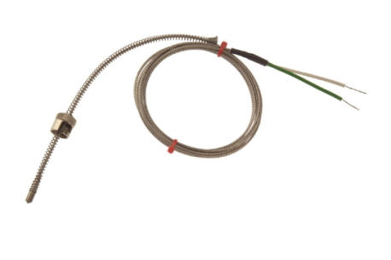
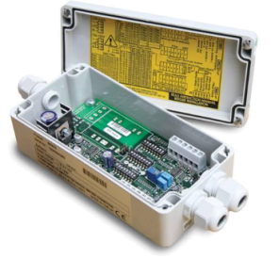
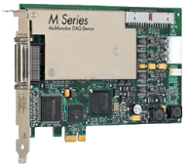
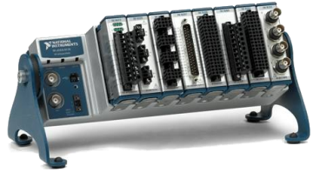


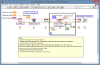
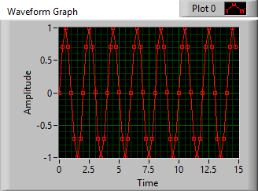



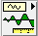


Transducer
Signal Conditioner
DAQ Hardware
Thermocouple
Amplifier, Low pass filter
NI CompactDAQ
Computer
Brought to you by IT
Phenomenon
Plotting
Software Basics
Cooling of Tea
Thesis/
Dissertation
Graduate!
Analysis
Curve fitting
DAQ
Storing Data
Analog Input
HDF5 Files
3

Slide 4
Software Development from 30,000 ft
Why do we develop software?
To interface with the real world via hardware
For flexibility
For extensibility
To enable us to acquire and process more than we could by hand
What do we need?
A problem
A plan (1)
A computer
A language (3)
Other tools
Editor or integrated development environment
Documentation tools (e.g. word processor)
Source code control (2)
Issue tracking database
Notes:
Whiteboard why
Whiteboard what we need

Slide 5
Software Design Life Cycle
Requirements Analysis
Design
Implement
Test
Evolution

Slide 6
Grad Student’s SDLC
Implement
Evolution
Notes:
Don’t do this!

Slide 7
Software Design Life Cycle
Requirements Analysis
Design
Implement
Test
Evolution
What must be done?
How will the user do it?
Time passes.
Needs change.
How the programmer make it happen?
Does it do what it’s supposed to?
Program!
Document!

Slide 8
Software Design Lifecycle
When developing any software, use it!
Even if you do the requirements analysis and design on a napkin
Absolutely required for large projects or projects with multiple people working on it
(We won’t be using much of the Evolution portion in this class.)

Slide 9
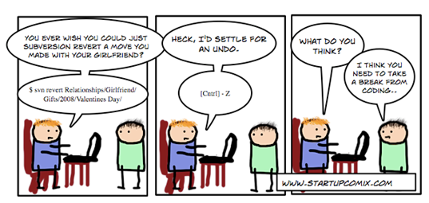
Source Code Control (SCC)
Also called Revision Control System (RCS) or Version Control system (VCS)
Keeps track of edits to code
Allows for review of history
Allows for global, long-term undo
Allows multiple people to work on code simultaneously
With minimal conflicts!
Allows for branching and merging
Notes:
Whiteboard branching and merging

Slide 10
SCC Choices
Numerous open source choices
In the stone age people simply copied files and folders and put dates on them
CVS is the senile grand-daddy
SVN is the aging prince
git is the scrappy upstart
Mercurial is also popular
Bazaar is dead (don’t pick this one)
Commercial choices
Perforce
Microsoft Team Foundation Version Control
IBM Rational ClearCase

Slide 11
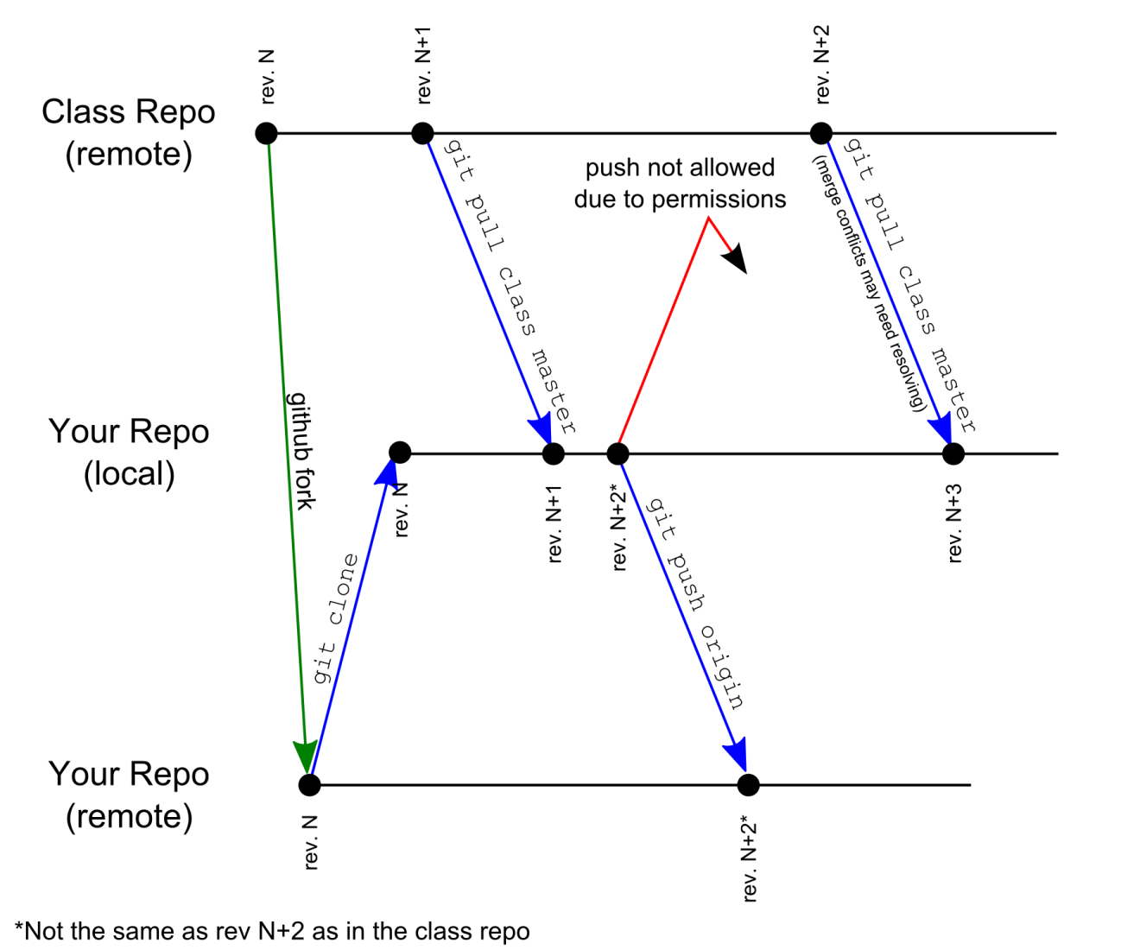
The github repos

Slide 12
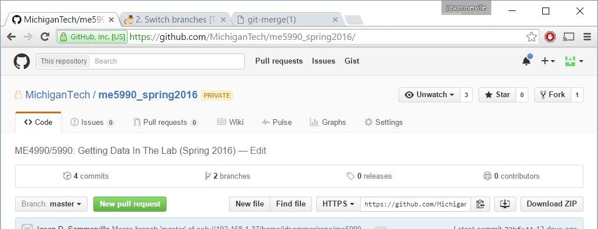
Forking the class git repository
Create a github account
E-mail me your github account username
Wait for a confirmation e-mail from github notifying you that you’ve been added to the MichiganTech organization
Goto http://github.com/MichiganTech/me5990_spring2016
Fork the repo by pressing the “Fork” button

Slide 13
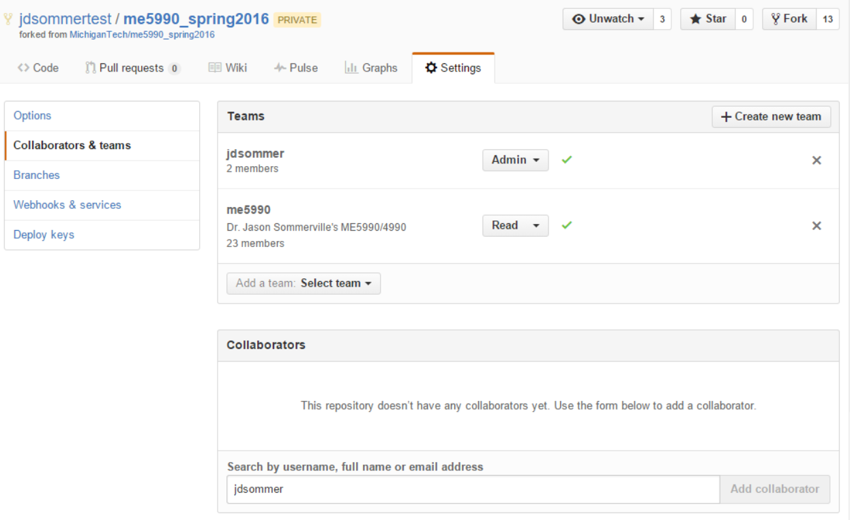
Forking the class git repository
Be sure to add me (jdsommer) as a collaborator to your fork!
If I can’t see it, I can’t give you credit. Also remove any inheritted users

Slide 14
Git tasks
Use the git bash shell (or your favorite GUI tool)
Getting a local copy of your github repo (the first time)
Sets up the “origin” name used for future pulls and pushes
git clone http://github.com/<username>/me5990_spring2016
Updating your local copy from your github repo (every other time)
git pull origin
Adding a file
Create the file, then
git add <filename>
Deleting a file
Don’t delete it without using git
git rm <filename>
Committing your changes
git stage then
git commit
Pushing your changes to your github repo
Must do this to get credit!
git push origin

Slide 15
Pulling Updates from the Class Repo
Be sure to pull updates regularly, especially before starting new homework assignments.
In your local repo, execute
git remote add class https://github.com/MichiganTech/me5990_spring2016
This need be done only once
Then, to pull the update execute
git pull class master
This will pull any changes down from the class repository and merge them with your local repository.
There is potential for conflicts if you have edited files that I have edited.
Follow git’s instructions that it will print after executing git pull to resolved the conflict

Slide 16
Good SCC Practices
How often should I check in (commit) my changes?
Working by yourself:
As often as you like, but no less often than when every feature or modification is completed
Working with others:
When a feature is completed and tested
Follow company/project guidelines
Be sure to use commit descriptions
Label or branch “public releases” for future reference

Slide 17
Update This Slide for git!!!
Alice
rev 1*
Alice
rev 2*
Alice
rev 1*
Alice
On Alice’s PC
Bob
rev 1*
Pulls head and
resolves conflicts
On Bob’s PC
Tries to push updates, fails
Pushes updates
Bob
rev 3
Pulls head revision
Pushes updates
Pulls head
SVN
Repo
rev 1
SVN
Repo
rev 2
SVN
Repo
rev 3
On Server
Time
* denotes a modified revision that has not been committed

Slide 18
Laboratory Software Choices
Language | Ease of Language | Development Environment | Data Acquisition | Instrument Control | Analysis Capabilities | Debugging Capabilities | UI Development Ease | UI Development Capabilities | Initial Cost
C/C++ | 1 | 5 | 3 | 4 | 2 | 5 | 1 | 5 | Low
Matlab | 3 | 4 | 2 | 3 | 5 | 3 | 3 | 2 | Med
Python | 4 | 2 | 2 | 4 | 4 | 4 | 4 | 4 | Free
LabVIEW | 5 | 4 | 5 | 5 | 4 | 4 | 5 | 3 | Med
My opinion on the effectiveness of the languages for laboratory usage. Scale of 1 = worst to 5 = best.
Notes:
With what languages is the class familiar?

Slide 19
What is LabVIEW?
Programming language
Graphical
General purpose (but…)
Data flow
Great for
Data acquisition
Data storage
Instrumentation control
Simple to moderately complex UIs
Rapid prototyping of complex software
Programming real time systems and FPGAs*
Okay for
Data analysis and plotting
Not so good for
Complex UIs
Embedded systems not supported by NI
*Provided you are programming an NI or compatible RT or FPGA system

Slide 20
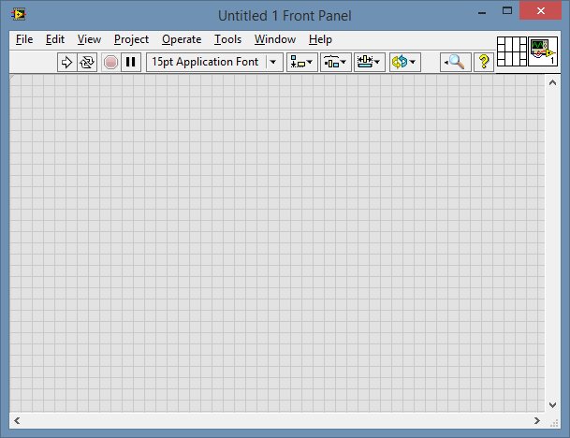
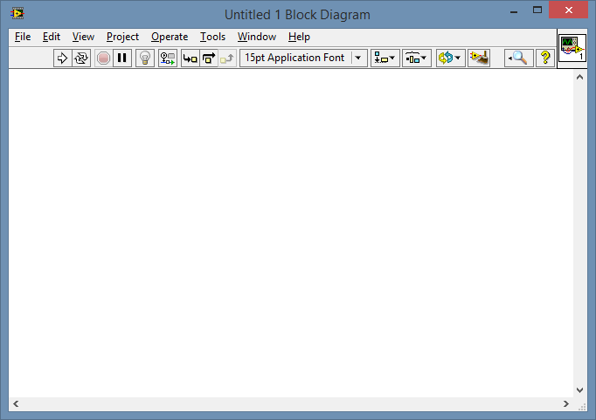
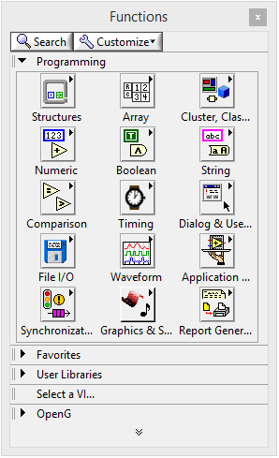
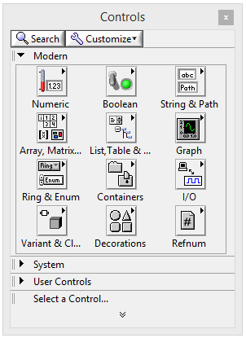
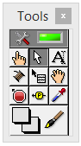
LabVIEW Environment
Front Panel
User interface goes here
Block Diagram
Code goes here
Function Palette
(BD Only)
Control Palette
Tools Palette
(FP Only)
Notes:
Palettes turn on and off from view menu
Also, right click and ctrl+right click

Slide 21
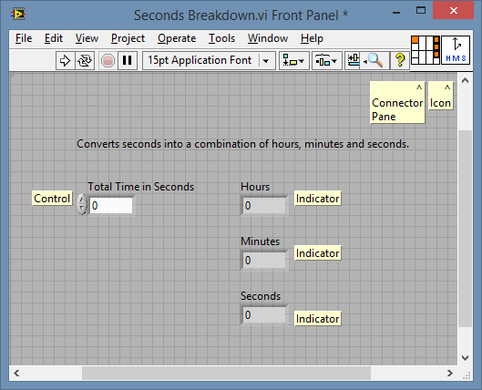
Front Panel
Place and arrange controls, indicators and decorations
Controls
Inputs to the VI
Indicators
Outputs from the VI
Create VI Icons and Connector Panes
Control Execution

Slide 22
Placing Controls

Slide 23
Toolbar
Run Continuously
Run
Abort
Font
Pause
Alignment, ordering, etc.
Run: start the VI’s execution
Run continuously: run VI in a loop, endlessly (rarely used)
Abort: This is not stop It’s ABORT!

Slide 24
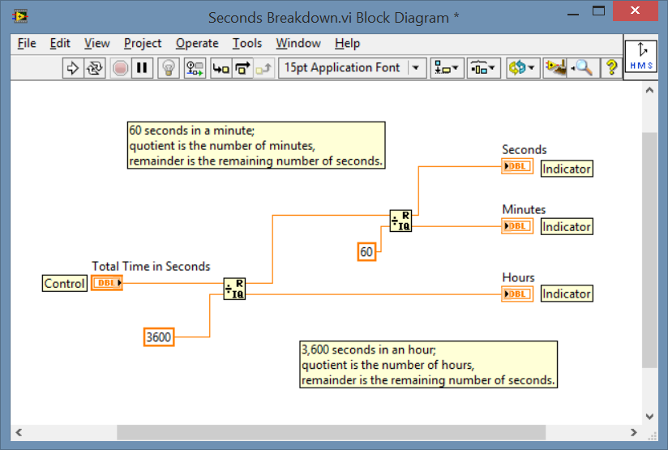
Block Diagram
Comment
Indicators
Control
Node (Function)

Slide 25
Toolbar
Execution Highlighting
Automatic BD “Cleanup”
Step Execution
Retain Wire Values
Execution Highlighting: watch the VI run (super slowly)
Retain Wire Values: Allows use of wire probes after VI exits
Step execution: Execute one node at a time

Slide 26
Control/Indicator Terminals
Indicator Pair
Control Pair

Slide 27

Building a Simple VI
Watch the Amazing Dr. Sommerville build a simple VI.
Notes:
Build this.

Slide 28
Dataflow
Watch VI run
Notes:
Run ApmB.vi

Slide 29
Numeric Control and Indicator Types

Slide 30
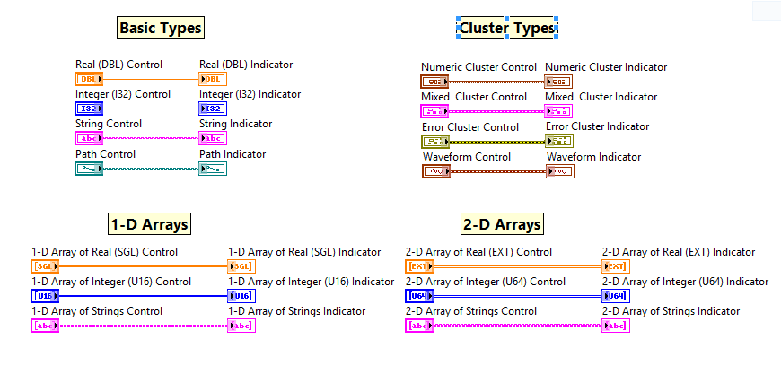
Data Types (Incomplete)

Slide 31
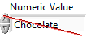
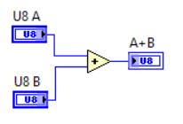
Data Types—Why should I care?
Using the proper data type forces the user/programmer to handle the data correctly
Using an unnecessarily large play will adversely affect performance
Using a numeric data type which is too small can lead to loss of precision or catastrophic rollover
Some numbers may not be exactly represented by floating values.

Slide 32
Integer Data Types
Unsigned:
msb
N bits (e.g. 32)
lsb
Signed:
msb
sign
N-1 bits (e.g. 31)
lsb
LabVIEW Name | Bits | Minimum | Maximum | Other Common Names
I8 | 8 | -128 | 127 | char, byte
U8 | 8 | 0 | 255 | unsigned char, unsigned byte
I16 | 16 | -32768 | 32767 | short
U16 | 16 | 0 | 65535 | unsigned short, word
I32 | 32 | -2147483648 | 2147483647 | int, long
U32 | 32 | 0 | 4294967296 | unsigned int, unsigned long, dword
I64 | 64 | ~-9x10¹⁸ | 9x10¹⁸ | qword, long long
U64 | 64 | 0 | ~2x10¹⁹ | unsigned qword, unsigned long long

Slide 33
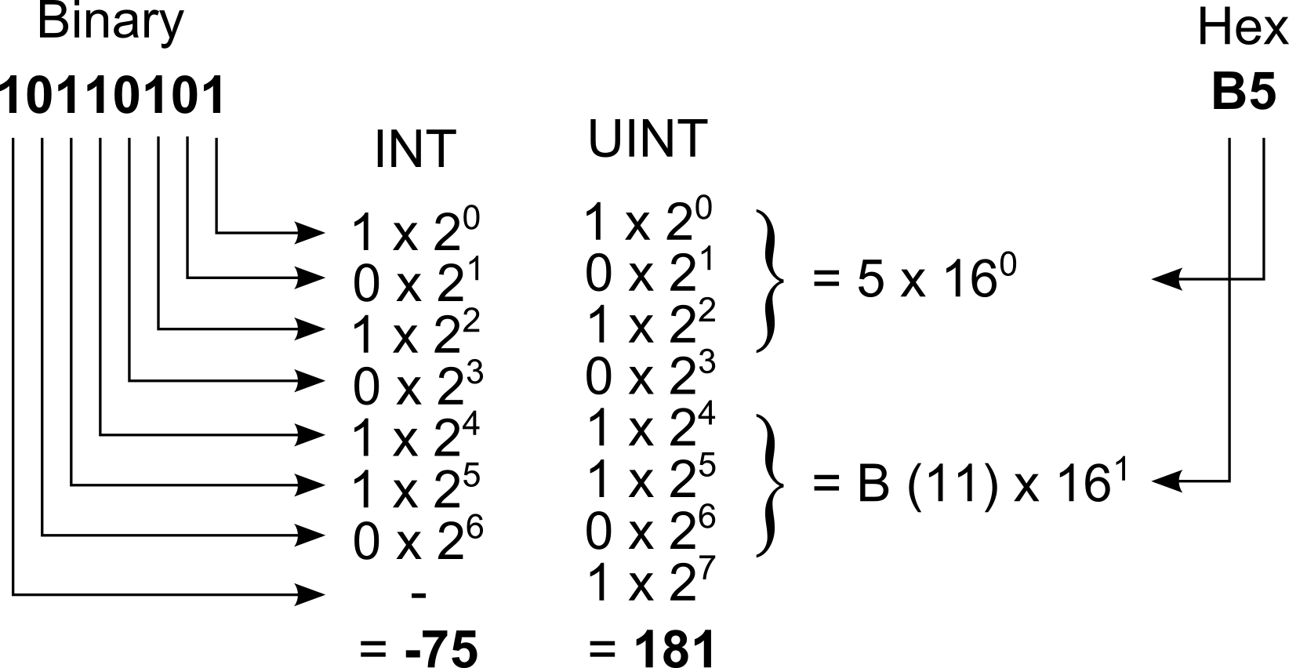

Binary, Decimal and Hex
Understanding how integers are stored is useful for understanding the effect of your data choice on program speed and data size
Binary flags in integers are often used in instrument communication protocols
Best TV Show Ever!

Slide 34
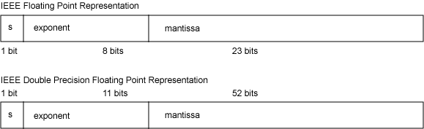
Floating Point Data Types
msb
lsb
msb
lsb
LabVIEW Name | Bits | Mantissa | Exponent | Decimal Exponent Range* | Decimal Digits of Precision (approx) | Other Common Names
SGL | 32 | 23 | 8 | -38 – 38 | 7 | float, real
DBL | 64 | 52 | 11 | -308 – 308 | 16 | double
EXT** | 80 | 64 | 15 | -4932 – 4932 | 19 | long double
* Does not include subnormal values.
**Platform dependent. Values for Windows platform shown.

Slide 35
Floating Point Data Types
How to calculate minimum and maximum exponents?
How to calculate digits of precision
If e is the number of bits in the exponent, the decimal exponents range is from
-2^(2^(e-1)-1)
to
2^(2^(e-1))
If m is the number of bits in the mantissa, the approimate decimal precision is
log₁₀(2^m)
digits.

Slide 36
Data Types—Which One?
Do restrict the data type to the type of information expected or required
Counting—use unsigned integers
Real numbers—use floats
Use strings only when necessary
Don’t unnecessarily restrict the data type
E.g. don’t use integers to represent length

Slide 37
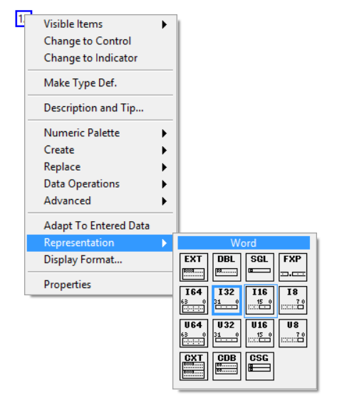
Numeric Data Types--Changing
Right-click on control, indicator or constant
Representation dialog

Slide 38
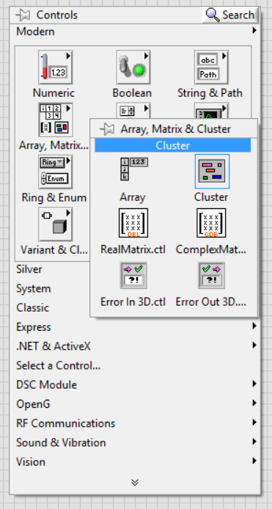
Clusters
Cluster group related, differently-typed data together
Equivalent to C/C++ struct or Fortran record
Classic example: address book entry
Scientific examples:
Data from multiple sensors
Meta-data (aka attributes)
Build an cluster

Slide 39

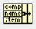
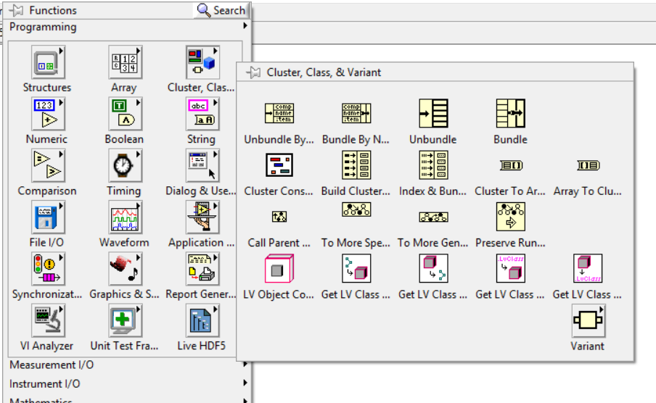
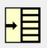
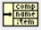
Working with Clusters
Bundle
Bundle by name
Unbundle
Unbundle by name
Demonstrate wiring clusters

Slide 40
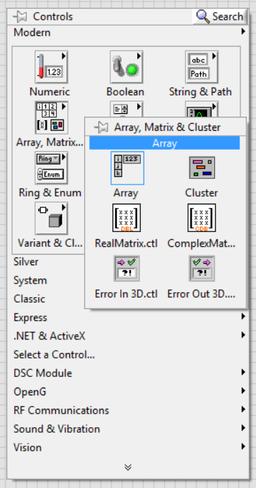
Arrays
Set of identically-typed values
N-dimensional
1-D: list, vector, etc.
2-D: table, matrix, image, etc.
3-D: tensor, gridded volume
4-D+: ???
1-D and 2-D arrays very common in data acquisition
Create an array

Slide 41
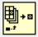
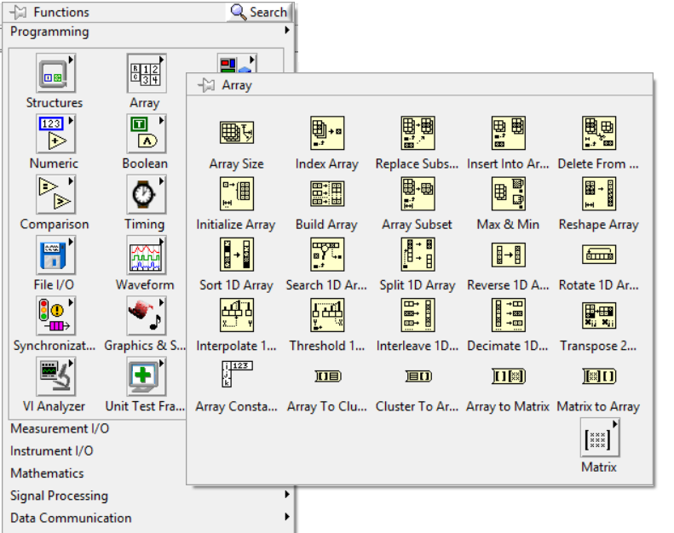
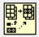
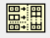
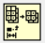
Working with Arrays
Array palette has numerous functions
Index array
Replace array subset (or element)
Build array
Array subset
And many more!
Work with arrays on screen

Slide 42
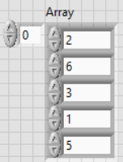
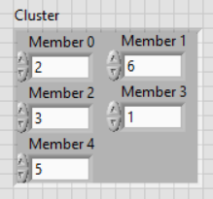
Arrays or Clusters?
All elements of the same type
Elements express dimensionality (e.g. space, time, frequency, etc.)
Elements should be indexed
Members are of different types (including different numeric types)
Members express differing concepts, but are related
Members should be named

Slide 43
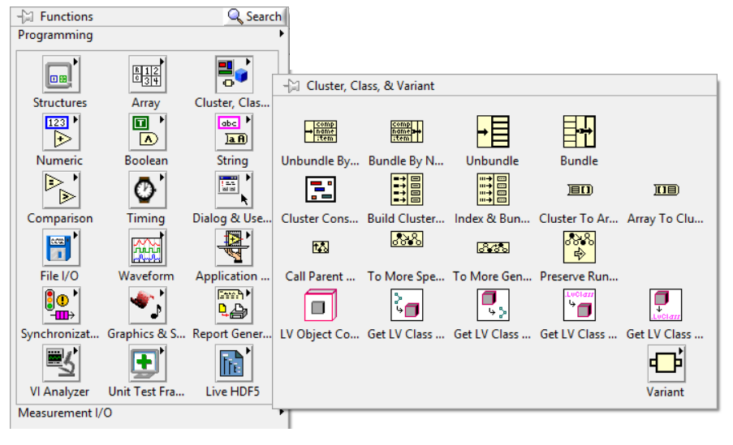
Arrays <-> Cluster

Slide 44
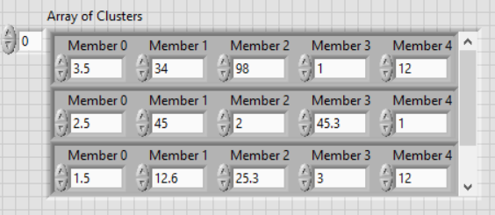
Arrays or Clusters—Why not both?
A common data type is the table
Naturally expressed as a 1-D array of clusters
LabVIEW display not limited to the above control

Slide 45
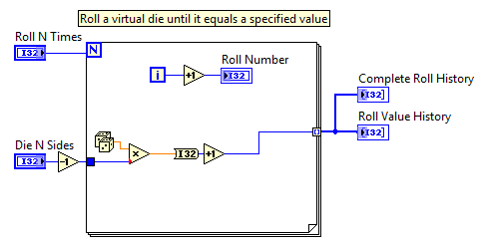
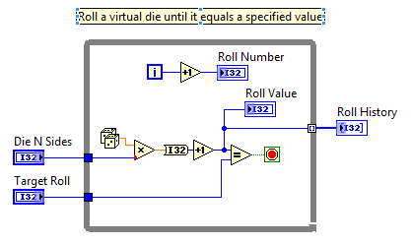
Loops
For Loop
While Loop
Iterate N times
Conditional may be added
Iterate until stop condition
Iterate while true condition
N Count
Stop Terminal
(click to switch)
Index Number
(0-based)
Notes:
RollN.vi and RollUntil.vi

Slide 46
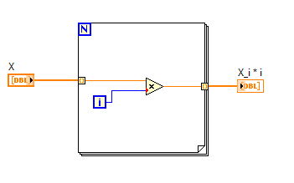
Auto-indexing
Arrays automatically index at input terminals
Arrays automatically built at output terminals
Indexing/non-indexing by right-clicking on terminal
Auto-building efficiency
For loops: efficient
While loops: inefficient
Runs as many iterations as array input
(unless wired)
Auto-building output terminal
Auto-indexing input terminal
Notes:
AutoIndexing.vi

Slide 47
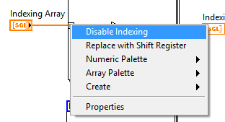
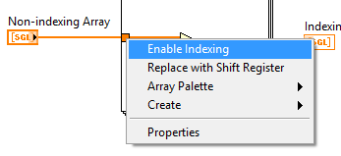
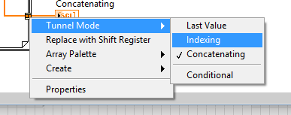
Auto-indexing
Enabling/Disabling indexing on input tunnels
Enabling/Disabling indexing/concatenating on output tunnels
Notes:
AutoIndexing.vi

Slide 48
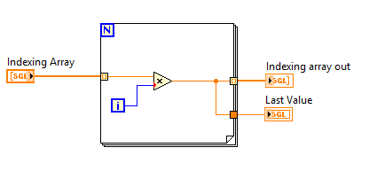
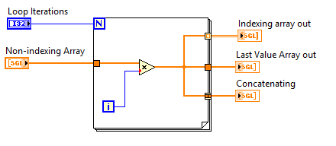
Auto-indexing
Tunnel options with scalars in the loop
Tunnel options with arrays in the loop
IndexingTypes.vi
Notes:
AutoIndexing.vi

Slide 49
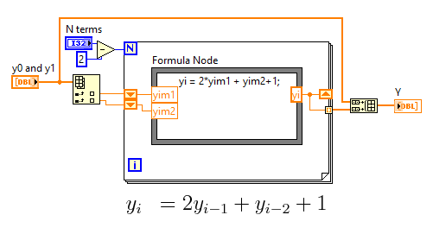
Shift Registers
Use previous values in a loop
Value at output terminal appears at input terminal on the next iteration
Create by right-clicking on loop boundary
Input terminals usually must be initialized
Shift register input terminal(s)
Shift register output terminal
Notes:
ShiftRegisters.vi

Slide 50
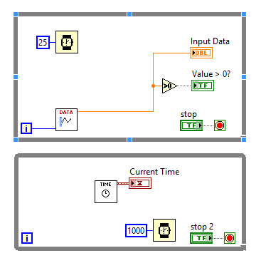
Parallel Loops
Parallel loops operate simultaneously
According to dataflow
Similar to multiple threads
Useful for
Processes that operate at different rates
Separating UI code (event-based) from DAQ code (time-based)
But how do I communicate from one loop to another?
Beyond scope
Local variables, global variables, message queues, semaphores, NI-PSP and other network-based solutions.
Notes:
LV1M37_Parallelism
Demonstrate flow control issues.
Modify LV1M37 to use a local variable stop button

Slide 51
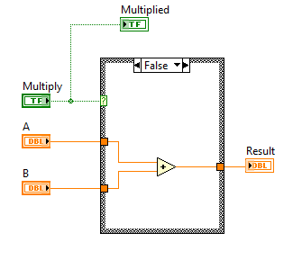

Case Statements
Case statements allow if-then-else or switch-type decisions
Conditional terminal
Case selector
CaseStatement.vi
Notes:
Show CaseStatement.vi
Modify to use multiple bools and array search
Modify to use Ring
Modify to use Enum

Slide 52



Case Statements
All output terminals must be wired unless “Use Default if Unwired” is selected
Unwired output tunnel => Broken VI
Unwired output tunnel, + “Use Default if Unwired” => Working VI
Notes:
Show CaseStatement.vi
Modify to use multiple bools and array search
Modify to use Ring
Modify to use Enum

Slide 53

Rings
Controls and indicators which map strings to integers
Is cosmetic only!
Useful for
Limiting or suggesting user selections
Create on the front-panel or the block diagram
Then populate the items by
A) typing directly into the control/indicator/constant
B) selecting “Edit Items…”

Slide 54

Enumerations
Enumerations give names to numbers like Rings, but…
An enumeration is a user-created datatype
Derived from unsigned integers
Useful for
Limiting user selections
Limiting programmer choices
Making code readable
Create on the front-panel or the block diagram
Then populate the items by
A) typing directly into the control/indicator/constant
B) selecting “Edit Items…”
Cast to U32 (U16 or U8) with standard conversion functions (Numeric -> Conversion palette)

Slide 55

Classic Event-Driven VIs
Typically, event driven VIs now use the event structure, but this construction can still be useful and is definitely instructive.
ClassicEventDrivenVI.vi

Slide 56

Sequence Statements
Force sequence of operations
No way to enforce sequencing via dataflow

Slide 57



Sequence Statements
Stacked Sequence Structures and Sequence Locals
Sequence Local
Notes:
Show CaseStatement.vi
Modify to use multiple bools and array search
Modify to use Ring
Modify to use Enum

Slide 58



Error Handling
Error Handling is primarily done through the Error Cluster
Error Cluster has three elements:
Boolean “status” error occurred
I32 “code” error code
String “source” location and message
Standard error terminals on bottom corners
Error handling dialogs

Slide 59



Case Statements—Error Cluster
Standard error codes are enumerated in the help file.

Slide 60

Error Handling (cont.)
USE IT!!
Almost all the VIs and primitives that you use have error cluster outputs.
Unexpected things go wrong, particularly for novices.
Even if you don’t understand the error, someone else probably does
Automatic error handling
Per VI
Enabled by default for unwired error outputs
Recommended error handling settings (for intermediate+ developers)

Slide 61


Waveform Datatype
Used to represent a time series of data
Could actually be any regularly sampled data
A special cluster
t0: Timestamp, time of Y₀
dt: DBL time step between Y points
Y:1-D Array of numeric type
(attributes: variant)
Uses different bundle and unbundle
On the waveform palette

Slide 62

Waveform Datatype
Default input/output type for timed DAQ
More on that later
Used by numerous signal generation and processing functions
Generate function (sin, square, etc.) wave data
Extract DC and RMS values
Apply digital filters

Slide 63

We Have Charts and Graphs
Waveform Charts
Keep a log of the previous data written to the terminal
If x-axis rate is constant, set Multiplier in the properties
Waveform Graphs
Plot data vs. time or otherwise regularly spaced x-axis
Uses, t0, dt and Y data array
Use Build Waveform to specify t0, dt and Y data
X-Y Graphs
Plot Y array of data vs. X array of data
Use Build Cluster to pair arrays
All charts and graphs can support multiple traces
Notes:
ChartsAndGraphs.vi

Slide 64


We Have Charts and Graphs
Properties may be accessed by right clicking on the chart/graph.
Plot styles and colors
Axes styles and labels
Gridline coloring and spacing
(Advanced!) Properties may also be modified via properties nodes
Right-click on terminal or control and select Create->Property Node
Allows more programmatic modification
Note: other controls and indicators have property nodes also.
Notes:
ChartsAndGraphs.vi

Slide 65
Project Update
Several professors may have projects in need of your help
Dr. John Beard: jebeard@mtu.edu
Instrumenting a vehicle suspension
Controlling an orthopedic device
Dr. Jeff Allen: jstallen@mtu.edu
Instrumenting a solar water heater
Dr. Ezequiel Medici: efmedici@mtu.edu
Field infrasound detection system
Dr. Scott Wagner (School of Technology): swwagner@mtu.edu
Tube forming process monitor
Dr. Jayaraman Gopal: gjayar@mtu.edu
Pedestrian protection system for motorcycles and scooters
Note that you must be a net positive for the professors. They’ll get you started, but you must work independently.

Slide 66
Project Update
I have a collection of sensors available for independent projects
Pressure
Humidity
Thermocouples
Accelerometers
Access to load cells
Stop by my office to have a look
I need them all back in the same condition you take them
You may need to find power supplies or other equipment to make them work

Slide 67

Quiz 1: Factorial

Slide 68
Other Announcements
No class Thursday
Homework still due
Start bringing your DAQs
We may use it in class next lecture
Quiz next Tuesday

Slide 69
SubVIs!
“LabVIEW sucks because I’ve got all these wires running all over the screen and I have to scroll everywhere and I can’t see the whole thing at once. Wah!”
–Novice LabVIEW Programmer

Slide 70

http://thedailywtf.com/articles/comments/Labview-Spaghetti

Slide 71

SubVIs!
SubVIs are like functions
Enable modular programming
Enable easier testing
Make high-level VIs make sense
But how do I make them?
Use the Connector Pane and the Icon
Wire controls and indicators to connector pane
Making a SubVI from scratch
Collecting code into a subVI
Notes:
Make a subVI for adding two numbers and subtracting a third.
Call it from Master.vi
Rebuild Master and show how to collect code into a subVI
Signal Generator by Duration.vi

Slide 72

The Connector Pane
Wire controls and indicators to the connector pane
Select the wiring tool
Click on the desired terminal
Click on the control/indicator you wish to associate with it
Notes:
Make a subVI for adding two numbers and subtracting a third.
Call it from Master.vi
Rebuild Master and show how to collect code into a subVI
Signal Generator by Duration.vi

Slide 73

The Connector Pane
Changing the pattern
You can change the connector pattern by right-clicking on the icon or connector pane
Also may flip and rotate the pattern
Right click also gives access to disconnecting controls/indicators from terminals
Notes:
Make a subVI for adding two numbers and subtracting a third.
Call it from Master.vi
Rebuild Master and show how to collect code into a subVI
Signal Generator by Duration.vi

Slide 74

Connector Pane Style
The following style guidelines help make subVIs easier to use
Prefer the 4x2x2x4 pattern
Avoid patterns with more than 16 terminals
I say 12
Use clusters to reduce the number of terminals
Wire inputs on the left
Wire outputs on the right
Wire error input to bottom left
Wire error output to bottom right
From LabVIEW Development Guidelines, 2003

Slide 75

Terminal Behavior
Terminals may be
Required: caller must wire this terminal or the VI will be broken
Input terminals only
Recommend: caller should wire this terminal
On inputs, default values will be used if unwired.
Optional: caller need not wire this terminal in most situations
Notes:
Make a subVI for adding two numbers and subtracting a third.
Call it from Master.vi
Rebuild Master and show how to collect code into a subVI
Signal Generator by Duration.vi

Slide 76

Editing the Icon
DO! Edit the icon of your subVIs (even it its lousy)
Right-click on icon -> “Edit icon…”
Or double-click on icon
Notes:
Make a subVI for adding two numbers and subtracting a third.
Call it from Master.vi
Rebuild Master and show how to collect code into a subVI
Signal Generator by Duration.vi

Slide 77



Using SubVIs
SubVIs may be placed in multiple ways
“Select VI…” palette menu
Drag file from file explorer
Drag from VI icon
1.
2.
3.

Slide 78

Where LabVIEW Looks for SubVIs
LabVIEW first looks for Vis of the appropriate name already in memory.
Then it follows the search path:
Tools -> Options menu, then
Relative to the top-level calling VI
Previous locations in which the VI was found
vi.lib folder of LabVIEW installation
user.lib folder of LabVIEW installation
instr.lib folder of LabVIEW installation
Others

Slide 79

Debugging SubVIs
SubVIs may be stepped into, over, or out
Into: When paused at a subVI, step into the subVI and examine its execution
Use when you are not sure if the subVI is behaving properly
Over: When paused at a subVI, step over the VI, executing it without examining it
Use when you are sure the subVI is not the problem
Out: When debugging inside a subVI, step complete the execution of the subVI and return to the caller
Note! These same behaviors also apply to loops. Read the tool tip over when hovering over the debug buttons to confirm the action you are about to perform.

Slide 80


Debugging SubVIs (cont.)
In this example, VI execution is stopped at a subVI with a breakpoint. The user is preparing to step into the subVI and debug its execution.

Slide 81
SubVIs: Conclusion
SubVIs allow for cleaner code
Code easier to read because one can quickly understand what a SubVI does by looking at it (mostly).
Functional blocks can be individually tested
Commonly used functions can be encapsulated
If the SubVI is changed, call callers inherit the improved behavior
Note: this usually a great thing, but occasionally it can be disastrous!
Code can be reused in multiple programs
USE THEM (or else!)

Slide 82
Review
LabVIEW is great for data acquisition
LabVIEW programs call Vis
Front panel is UI
Block diagram is code
FP and BD linked by controls and indicators
Code executes in dataflow
Datatypes
Decisions made with case statements
For loops and while loops to repeat code
Arrays auto-index and auto-build
Shift registers to use and update values in a loop
Parallel loops execute simultaneously
Charts and Graphs
Waveform Charts keep a history
Waveform Graphs for plotting data with regular x intervals
X-Y charts for irregular data
Use SubVIs to modularize code
Controls and indicators are inputs and outputs
Use Connector Pane to associate controls and indicators
“Create SubVI”
Error Handling
Error cluster
Checking for errors
“Raising errors with General Error Handler.vi”

Slide 83
Homework
From the LabVIEW Help file, read:
Fundamentals -> Loops and other Structures
Fundamentals -> Graphs and Charts
From NI’s LabVIEW Core 1 Exercises
LV1M 3, 4, 5, 6, 9, 15, 17, 18, 21, 22, 23
Due 2015-04-07

Slide 84
Transducer
Signal Conditioner
DAQ Hardware
Thermocouple
Amplifier, Low pass filter
NI CompactDAQ
Computer
Brought to you by IT
Phenomenon
Software Basics
Plotting
Software Basics
Cooling of Tea
Thesis/
Dissertation
Analysis
Graduate!
Analysis
Curve fitting
Curve fitting
DAQ
Storing Data
Analog Input
HDF5 Files
2015-04-07
84

Slide 85


Analysis
LabVIEW has numerous functions for analyzing data
May not be the best choice for all analysis
Is your analysis simple, consisting of only a few steps?
Does your analysis need to be online during your acquisition?
Do you know exactly what you want to do to analyze your data?
Other choices:
Diadem
Igor
Matlab
SciPy + NumPy + Python
It is possible to incorporate analysis functions from Diadem or Matlab into LabVIEW
Some of the palettes with analysis functions
Notes:
ChartsAndGraphs.vi

Slide 86

Simple Analysis
Acquire N measurements, computer average and std. dev.

Slide 87

Simple Analysis
Apply a low-pass filter
Notes:
ChartsAndGraphs.vi

Slide 88
Transducer
Signal Conditioner
DAQ Hardware
Thermocouple
Amplifier, Low pass filter
NI CompactDAQ
Computer
Brought to you by IT
Phenomenon
Software Basics
Plotting
Software Basics
Cooling of Tea
Thesis/
Dissertation
Analysis
Graduate!
Analysis
Curve fitting
Curve fitting
DAQ
Storing Data
Analog Input
Storing Data
HDF5 Files
HDF5 Files
2015-04-07
88

Slide 89
Saving Data
What to save?
Dataset: The raw data (if feasible)
Intermediate results (standard deviations and other simple processing)
Attributes (aka properties, metadata):
Date
Time
Purpose of data (comments)
Acquisition information (instrumentation, settings)
You can’t save too many details!
You never know what you’ll wish you had recorded latter
Saving processed results?
Best to save in separate files
Use attributes to describe the raw data source and processing methods
Notes:
ChartsAndGraphs.vi

Slide 90
Saving Data: What Format?
File I/O
Text, CSV
Raw binary
Self-describing formats
TDMS
NetCDF
HDF5
Etc.
Databases
Use Simple Query Language (SQL) to write, search, etc.
Data organized in cross-linked tables
MySQL, postgresql, SQLite, Access, Oracle, etc.
Notes:
ChartsAndGraphs.vi

Slide 91
Data Formats: Preliminaries
I will primarily talk about writing data, not reading it
Very often, LV is used for acquiring data and saving it
Decisions are normally made when writing the file. When reading, the decisions are made for you.
In most circumstances, there is no one “right” answer
In most circumstances, there are many wrong answers!
Notes:
ChartsAndGraphs.vi

Slide 92
Text Files
Advantages
Disadvantages
Easy to understand
Always work
Portable to any computer
All computers have software that can inspect them
Readable by all processing software
Great for archival data
100 years from now, Notepad will still exist
Inefficient
Disk space
Processor speed
Difficult to represent higher-rank data (>2-D)
Annoying to store attributes
Difficult to show relationships between datasets
Gotchas: Line endings differ from platform to platform (CR, LF, CR+LF)

Slide 93

Text Files: Delimiters
Data is usually delimited by a character. Common choices are
Comma
Tab (my favorite)
Space
Sometimes data is in fixed columns
A new field starts at given character column numbers
E.g. column 1, column 11, column 21 …
Fields are padded by spaces or zeros to fill the column
Common for FORTRAN programs

Slide 94

Text Files What’s wrong with this file?
Notes:
No headers
No attributes
No units

Slide 95

Text Files Better with column headers
Notes:
Column headers with units

Slide 96

Text Files Header alignment fixed when imported to Excel

Slide 97

Text Files Even better
Notes:
Now with attributes

Slide 98

Text Files Best practices for writing text files in LabVIEW
Don’t use Write To Spreadsheet File.vi
No headers, attributes, or good error handling
Do write your own SubVI specific to your data
Use string function Array to Spreadsheet String liberally
Write attributes and headers
Develop a file and directory naming convention and stick to it
Watch and learn…

Slide 99

A Complete CSV Writing VI
Write My Data to CSV.vi

Slide 100
Logging Data
Examples shown write all data at the end of the program
For extended experiments, write more frequently
Don’t risk loosing all the data!
Logging can be done in all formats
Make sure to leave the file open
Repeatedly opening and closing the file is very time consuming and unnecessary
BEWARE of file buffering
Data is not written to disk on every software write call
For efficiency, modern systems wait until a sufficient amount of data is written and then flush it to disk all at once.
For critical data, force the write by calling the flush call appropriate to your format
Note that flush is time-consuming

Slide 101

Logging Data

Slide 102
Logging Data
1. Open
(2. Configure)
3. Read/Write
4. Close

Slide 103
Interlude: What is ASCII Text?
As far as your computer is concerned, text is no different than binary data.
Each character—letter, number, punctuation, whitespace, corresponds to an 8-bit number
(I’m ignoring Unicode and other multi-byte encodings)

Slide 104

ASCII Table
https://upload.wikimedia.org/wikipedia/commons/thumb/1/1b/ASCII-Table-wide.svg/2000px-ASCII-Table-wide.svg.png

Slide 105

Raw Binary
Advantages
Disadvantages
Most efficient (no overhead)
Can store arbitrarily complex data
Complete control over how data is saved
Useful if application-specific knowledge can save space or time
Extremely limited software selection
Only your software can read/write it
Files unintelligible without format documentation
Don’t lose it!
Terrible for archival data
Gotcha: Byte order

Slide 106

Big Endian vs. Little Endian

Slide 107

Raw Binary
Important for arrays and strings!
Prepend length dword so read back knows how fields to read
Path or file refnum
Can be anything
Endianness!

Slide 108

Raw Binary

Slide 109



What is a self-describing format?
Format that allows arbitrary data to be stored in a binary format
But, format follows an accepted standard
Contents of the file may be discovered
Enables data interchange with other software packages
Enables a generic viewer application
CDF
TDMS

Slide 110
Self-describing formats
Advantages
Advantages (cont.)
More efficient than Text
Many formats can store arbitrarily complex data
Format provides mechanisms for common features
Higher-order datasets
Attributes
Images
Format may allow grouping of datasets
Data easily inspected
With format-specific software
Many software packages will be able to read it
But check first!
Disadvantages
Not as widely used as text
Less efficient than raw binary
Data customers may not like it

Slide 111
Example: HDF5
Hierarchical Data Format 5
Data stored in a tree inside the file
Groups, datasets, attributes
HDFView application
Native library supports
C/C++
FORTRAN
Java
Also Supported by
Matlab
V7.3 .mat files are HDF5
R
Igor
Python (h5py, pytables)
LabVIEW (Live HDF5)
HDFView
Viewer application for HDF4 and HDF5
Download library and viewer from http://www.hdfgroup.org
Open an HDF5 File with HDFView

Slide 112
HDF5 Data Model
File
Attrs
Datatype
Attrs
T
Describes type data in dataset (e.g. int, float, compount)
Group
Group
Attrs
Attrs
Dataset
Dataset
Dataspace
Group
Describes rank and extent of dataset

Slide 113

Aside: VI Package Manager
Use the VI Package Manager to find add-ons and toolkits for LabVIEW
Tools Menu -> VI Package Manager
Example: Download and install LiveHDF5

Slide 114

Simple Live HDF5 Write with Attributes
Live HDF5 Examples, Write My Data HDF5.vi, Log My Data HDF5.vi

Slide 115

TDMS Organization

Slide 116
Example: TDMS
TDMS is an NI-created format that is similar to HDF5 and netCDF
Pros | Cons
Natively stores waveform datatype | Complex data may be difficult or impossible to store
Handles dataset and group attributes | Does not handle full hierarchy. Only one level supported.
Extremely fast for streaming data to disk
Easy to work with in LabVIEW | Closed format
Freely available interface library for reading/writing from other programs (which I can’t seem to find!) | Library is windows only
Works great in the NI-osphere | Limited support outside the NI-osphere

Slide 117
In class exercise
Modify “File Writing Example” to use waveform data.
Remove the Raw Data option
First modify “Write My Data (CSV).vi” to accept a 1-D array of waveforms
Then “Write My Data (HDF5).vi”
Then “Write My Data (TDMS).vi”

Slide 118
Hint
Write My Data to CSV.vi

Slide 119

Boolean Behaviors
Boolean buttons can have different behaviors:
Latch
Like momentary contact switches
Once button terminal is read, button returns to original state
Switch
Like toggle switches
Button stays at new state until it is pressed again
When?
Pressed: as soon as it’s pressed
Released: only when the user has released the mouse button
Until released: activate only while the user has the button pressed
BooleanBehavior.vi

Slide 120
Design Patterns
So far, most of our VIs have been sequential
They start
They read controls and/or acquire data
They write to indicators and/or files
They exit
This is not always sufficient
What if there are multiple processes that you may need?
What if you need to reconfigure something in the middle?
What if you want to pause your acquisition?
What if an error occurs and you’d like to try to recover?
We need a plan
And a while loop
Notes:
ChartsAndGraphs.vi

Slide 121

Design Patterns
Common patterns that solve common problems
State machine
Master-slave
Producer-consumer
Queued message handler
Patterns may be mixed and matched
But try not to overdevelop
Templates available for each of the above patterns
Menu File->New…
From Template->Frameworks-> Design Patterns
Notes:
ChartsAndGraphs.vi

Slide 122

State Machine
Architecture for responding to events called state changes
State machine can be described by a state chart
Base pattern for any non-sequential program
Example
Suppose a want to have a program that launches one of two programs when the appropriate button is pressed:
LV1M36
Notes:
Build LV1M36

Slide 123

State Machine
LV1M36
Notes:
Build LV1M36

Slide 124
State Machine Maintaining State Info
Complex state machines maintain more information about the state. Called:
State Data, or
State Information, or
The State
Information is used to make state transition decisions
Not all state data may be relevant to all states
Data typically maintained in shift registers in a while loop
Level2a.vi
Notes:
Show Level2a

Slide 125

State Machine Example 2
Requirements
Update clock (date and time) at 1 Hz
Collect data and update graph at 10 Hz
Turn on an indicator if the data value is > 0
User may start and stop processes independently with boolean buttons
Exit VI when stop pressed
State data: timers enabled
State data: time expiry
Level2a.vi
Notes:
Show Level2a

Slide 126






Aside: Making Graphs
Microsoft Visio is the standard tool
Microsoft PowerPoint or other presentation software also works
Vector drawing programs like Illustrator and Inkscape
But, for the truly cheap and lazy I recommend GraphViz (www.graphviz.org)
Source: http://graphs.grevian.org/example

Slide 127

Event Structure
Responds to events
FP User events, e.g. “Button pressed”
DAQ events, e.g. “Data Available”
Custom events generated by software
Timeout
Should be called inside a while loop
Timeout (default: never)
Event Selector
Event Info
(growable)
EventDemo Empty.vi
Gotcha 1: By default, FP is locked while event cases execute
Gotcha 2: Latch-behavior buttons not release until the terminal is read. Therefore, place terminal inside “Value Change” event case.
Notes:
Build EventDemo Empty.vi

Slide 128
Level2a w/ Event Structure
Modify Level2a to use event structure

Slide 129
States vs. SubVIs

Slide 130


Aside: Local Variables
Local variable provide additional terminals for controls and indicators.
Terminals may usually be either read or write
Allows the programmer to read from an indicator
Allows the programmer to write to a control
Create by right-clicking on
FP control/indicator
BD terminal
Change variable direction by right-clicking on local variable
“Change to read/write”
LocalVariables.vi

Slide 131
Aside: Local Variables
Local variables should be used sparingly
Avoid using them simply to pass data between loops or other disconnected program parts
Locals are inefficient
Locals can be confusing: “Why is this control changing value?!”
Prefer shift registers, or queues and other synchronization primitives
Usually good uses:
Programmatic override of control values
Uh… that’s all I can think of

Slide 132

Reminder: Continuous Sampling
Acquiring data forever
But how will I graduate?
Specify number of samples to read.
Defaults to “all available.”
See also NI Example: Voltage – Continuous Input.vi
Notes:
Modify Finite into Continuous

Slide 133

State Machines and DAQ
Investigate StateMachineDAQ.vi

Slide 134


Aside 2: Typedefs
Typedefs are a special type of control, indicator, or constant
Typically used for enumerations and clusters
Allows for central definition of the datatype
When the definition is changed, all instances are updated
Create by right-clicking and select “Make Typedef”
Creates a special LabVIEW “.ctl” custom control file.
More info:
LabVIEW Manual->Fundamentals->Building the Front Panel->Concepts->Creating Custom Controls, Indicators and Type Definitions
http://digital.ni.com/public.nsf/allkb/1B04FD6A11E6F17286256C6300588BFA
https://en.wikipedia.org/wiki/State_machine_(LabVIEW_programming)
You can recognize a typedef constant or terminal by the triangle
Create a Typedef

Slide 135

Exercise
Add a OK button to the FP labeled “Process 1”
When the button is pressed, or when the file is closed, execute a new state “Process 1”
Process 1 should put up a dialog that says “Blocking Process”
Note that this is, in fact, a blocking process.

Slide 136

Master/Slave Pattern
Built on two concepts:
Loop parallelism
Notifiers
Notifiers allow single messages to be passed between independent loops
Concept exists in all multi-theaded, multi-process or otherwise multi-tasking languages
One or more tasks/loops sends a notification
One task waits for the notification and process it
LabVIEW: Programming -> Synchronization -> Notifier Operations palette
Notes:
Build EventDemo.vi

Slide 137

Master/Slave Pattern
Master/Slave Design Pattern (New…->VI->From Template->Frameworks)

Slide 138

Master/Slave DAQ
MasterSlaveDAQ.vi

Slide 139


Producer/Consumer Pattern
Built on two concepts:
Loop parallelism
Queues
Queues allow messages or data to be passed between independent tasks
Is a FIFO buffer
Concept exists in all multi-theaded, multi-process or otherwise multi-tasking languages
One or more tasks/loops enqueue elements into the queue
One task dequeues the elements and processes them
LabVIEW: Programming -> Synchronization -> Queue Operations palette
Notes:
Build EventDemo.vi

Slide 140

Producer/Consumer Pattern
Queue Reference
Data Enqueued
Producer Loop
Queue Created
Data Dequeued
Consumer Loop
Producer/Consumer Design Pattern (New…->VI->From Template->Frameworks)
Notes:
Build a demo from the Producer-Consumer pattern.

Slide 141
Message Handler Architecture
A design pattern the combines Producer-Consumer with State Machine patterns and allows for a greater amount of flexibility
Enables multiple state changes to be queued, like producer-consumer
Enables bidirectional communication between loops
The same architecture underlies most GUI programs in other languages.
See, for example, WinMain and GetMessage for the Windows API
Note that higher level languages (C#, ObjectiveC) and frameworks (e.g. Qt) may hide the event loop, but it’s still there!

Slide 142
Aside 3: Variants
LabVIEW is strictly-typed
The data in a wire (shift register, control, etc.) must always be the same type.
Data type can only be changed during edit-time, not run-time.
Except for the LabVIEW Variant data type
As the name suggests, the data in it can be of varying types
Great as a way to move data around, but LabVIEW can’t do much with them
Think of a Variant as an wrapper around an unknown piece of data
To create the Variant, we “wrap” another datatype
To use the data in the variant, we must first unwrap it
And then hope it’s the right type
VariantDemo.vi

Slide 143

Message Handler Architecture
The pieces we need
In github -> vilib/Message

Slide 144
Message Handler Architecture
Message Based Application Template.vit
Exercise/HW05: Message Based DAQ.vi

Slide 145
Message Handler Architecture
LabVIEW provides a template project
File->Create Project…-> Queued Message Handler
It is overly complicated for many applications
It does provide better program assurance than what I just showed you
Strictly-typed messages,
Ensure there are no unrecognized messages
Arguably cleaner error handling

Slide 146
Review: Lectures 3 and 4
Analysis
LabVIEW can do it
Often helpful to process online to know if results are good
When choosing a data format consider:
Who’s using it and when?
Portability
File size
Archival needs
Text files
Good for 1 or 2 dimensional data
Always write column headers
Write attributes at the top of the file
Self-describing formats
Usually the best choice
Can be both powerful and easy to use
Design patterns
Solve common problems
Templates are available in LabVIEW
State Machine
Most non-sequential programs use it
States control the execution
Decisions are made to change the state
State information is maintained
Shift registers in LabVIEW

